Slide 1
OSI network layer
CCNA Exploration Semester 1
Chapter 5

Slide 2
OSI network layer
OSI model layer 3
TCP/IP model Internet layer
Application
HTTP, FTP, TFTP, SMTP etc
Presentation
Data stream
Application
Session
Transport
Segment
TCP, UDP
Transport
Network
Packet
IP
Internet
Data link
Frame
Ethernet, WAN technologies
Network Access
Physical
Bits

Slide 3
Network layer topics
IP version 4 – the most common layer 3 routed protocol
Dividing hosts into groups – why and how
Routing – sending packets the right way
Routing – how routers learn routes
IP addressing – in chapter 6

Slide 4
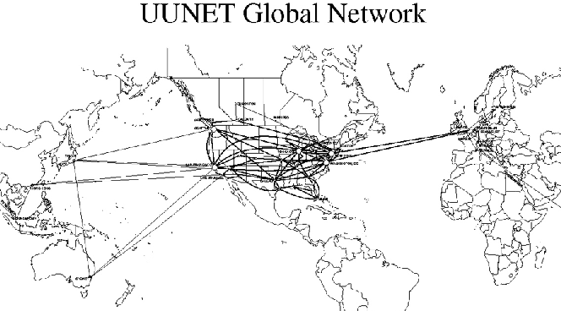
Purpose of layer 3
Decide how to get the data from source to destination, then route it.

Slide 5
Layer 3 protocol
A layer 3 protocol such as IP version 4 must:
Provide an addressing scheme to identify networks and individual hosts
Encapsulate a segment from layer 4 into a packet and include addresses
Direct the packet across one or many networks to the destination host
Decapsulate (remove the packet header) and give the segment to layer 4.

Slide 6
Network layer protocols
Internet Protocol version 4 (IPv4) – the most common
Internet Protocol version 6 (IPv6) – designed to replace version 4 eventually
Novell Internetwork Packet Exchange (IPX)
AppleTalk
Connectionless Network Service (CLNS/DECNet)

Slide 7
IP characteristics
Designed with low overhead for speed – it does only what it needs to do.
Connectionless – does not set up connection with destination before sending packet.
Best effort (unreliable) no guarantee of safe delivery, no checking or resending.
Independent of media, but does need to know maximum packet size.

Slide 8
Network layer encapsulation
Segment from transport layer
Packet header added to make IP packet
Sent to data link layer for further encapsulation into frame

Slide 9
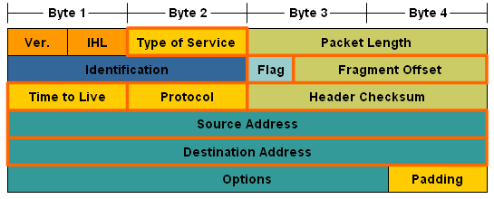
IPv4 packet header fields
IP address of source host, needed so reply can be sent.
IP address of destination host, needed so routers can find route.

Slide 10
IPv4 packet header fields
Reduced by 1 at each router. Packet dropped if it goes to 0.
TCP or UDP used in Transport layer.

Slide 11
IPv4 packet header fields
Priority for QoS. E.g. voice data has higher priority than e-mail.
For checking if header has been corrupted.

Slide 12
IPv4 packet header fields
Shows if packet has been fragmented or must not be fragmented.
If router has to split a packet, this gives order for putting pieces together.

Slide 13
IPv4 packet header fields
Version 4.
Header length.
Length of whole packet.

Slide 14
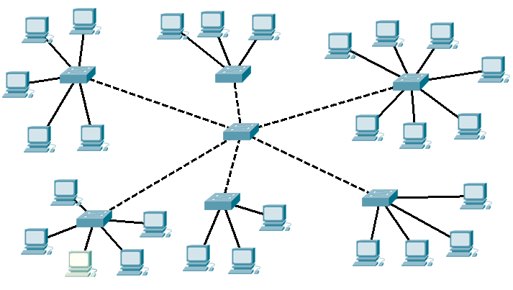
Splitting up networks
Fully switched network, each device has its own bandwidth. You could have hundreds of computers. Why split it up?
Too large to manage efficiently
Too much broadcast traffic - congestion
Too many addresses for switches to remember
Lack of security

Slide 15
How to split the network
Geographically – different sites
Purpose – what software and shared resources do people use? How much bandwidth do they use?
Ownership – different companies or departments in a company, security requirements

Slide 16
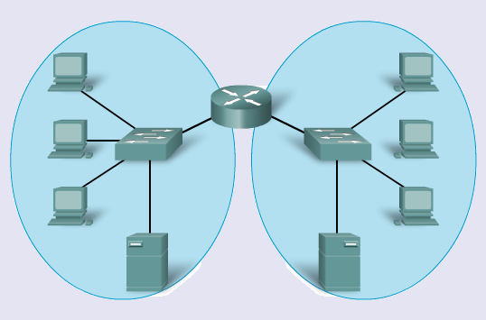
Use a router
Limits broadcasts
Can provide security
Addressing scheme based on networks - hierarchical

Slide 17
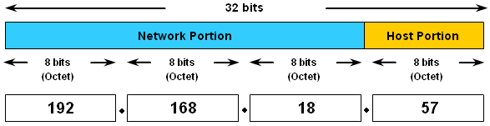
IPv4 hierarchical address
32 bits in four 8-bit octets, written in decimal
Network part then host part
Here network part (prefix) is 24 bits /24
Length of network part can vary.

Slide 18
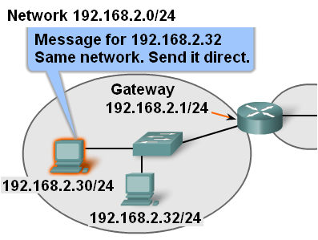
Message to same network

Slide 19
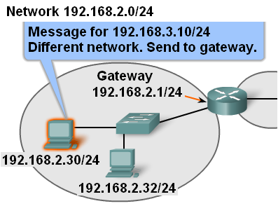
Message to different network

Slide 20
Default gateway
Each PC is configured with an IP address and a default gateway.
The default gateway is the IP address of a router port on the same network as the PC.
It is the router’s job to handle messages to other networks.
Each router port is on a different network and has a different IP address.

Slide 21
Hops
A packet may pass through many routers on its journey.
The trip from one router to the next is called a hop and the next router is called the next hop router.
Each router looks at the IP address in the packet header and decides what to do with the packet next.

Slide 22
Routing table and forwarding
Each router has a routing table. This contains a list of known networks and the best way to get there – outgoing port and address of next-hop router.
The router looks at the IP address of a packet. It decides which network this address is on.
If it knows the network it forwards the packet.
If it does not know the network it drops the packet.

Slide 23


Directly connected
The networks of the router’s own interfaces go into the routing table.

Slide 24
Other networks
Routes to other networks can be configured by an administrator (static routes)
Or they can be learned from another router using a routing protocol (dynamic routes)
A router can have a default route. Packets for unknown networks go on this route instead of being dropped.

Slide 25
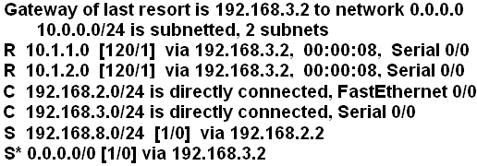
Routing table entries
Directly connected shown by C

Slide 26
Routing table entries
Static, configured by administrator, shown by S

Slide 27
Routing table entries
Default, configured by administrator, shown by S*

Slide 28
Routing table entries
Learned from another router using RIP routing protocol, shown by R

Slide 29
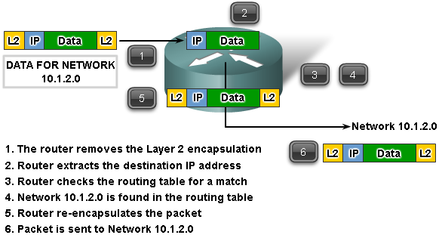
Router has a route

Slide 30
Routing protocols
Routers learn routes from each other and put them in their routing tables.
A routing protocol is the set of rules they use to swap information.
These routes are dynamic routes

Slide 31
Static routes Dynamic routes
Entered by administrator
Time consuming, different for each router
Must be updated if routes change
Little processing
No bandwidth used
Gives nothing away
Learned from other routers
Start the protocol then it runs by itself
Automatically updates when routes change
More processing
Uses bandwidth
Gives away information

Slide 32
The End

